Slide 1

Ratings Prediction Project
K. Rahul Ramanujam

Slide 2

Problem Statement: We have a client who has a website where people write different reviews for technical products. Now they are adding a new feature to their website i.e. The reviewer will have to add stars(rating) as well with the review. The rating is out 5 stars and it only has 5 options available 1 star, 2 stars, 3 stars, 4 stars, 5 stars. Now they want to predict ratings for the reviews which were written in the past and they don’t have a rating. So, we have to build an application which can predict the rating by seeing the review.
The problem statement is pretty self-explanatory:
The model have to be built in such a way that it predicts the ratings when reviews are given as inputs.

Slide 3

Data Collection Phase: You have to scrape at least 20000 rows of data. You can scrape more data as well, it’s up to you. more the data better the model.
In this section you need to scrape the reviews of different laptops, Phones, Headphones, smart watches, Professional Cameras, Printers, Monitors, Home theater, Router from different ecommerce websites.
Basically, we need these columns
1) reviews of the product.
2) rating of the product.
You can fetch other data as well, if you think data can be useful or can help in the project. It completely depends on your imagination or assumption.
→ I have scraped the data from the flipkart website with the help of selenium. Around 35K rows of data has been scraped, it helps in better modelling.

Slide 4

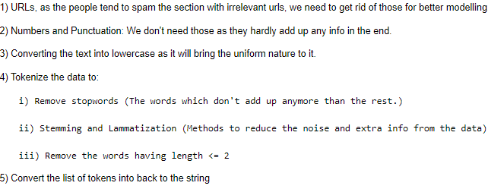
Text Pre-Processing: It is a stage where the data is made to undergo the changes like shown below with the help of NLP.
All that is mentioned above summate to be an extra added information to the data. By getting rid of it, the modelling becomes easy as the information which matters stays and the rest goes.

Slide 5
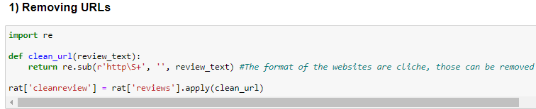

1) Removing URLs: There are higher chances that people tend to post urls or website links in the reviews section of the products. Thus, we write a code to get off those from the data for the better modelling.
2) Numbers and Punctuations off the data: The data contains numbers and punctuations which are unnecessary for the model.
← The change can be seen here.

Slide 6
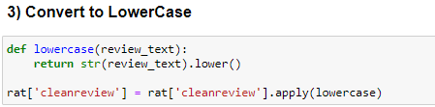
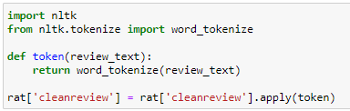
3) Convert to Lower case: The data which has upper case letters will be converted to lower case as it affects the uniformity of the data.
← Change can be seen here.
4) Tokenization: The data should be broken down to words in order to perform rest of the operations like removing stopwords, stemming, lammetizing etc.

Slide 7
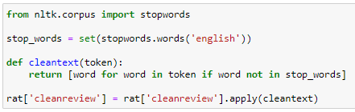
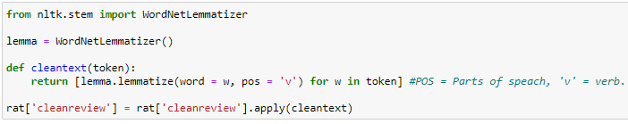
Removing Stopwords: The stopwords which do not make sense to the data will be removed with the help of NLP tool kit aka NLTK.
← The words like is, not, the been removed.
Lemmatizing: I used lemmatizer to reduce the length of the words and still abide by the dictionary.

Slide 8


Removing the words having length <2: There might be letters like I, e, u, m which do not make any sense to the data, those should be removed.
5) Snitching tokens back to the string: The tokens or the words will be attached back to form a sentence.

Slide 9
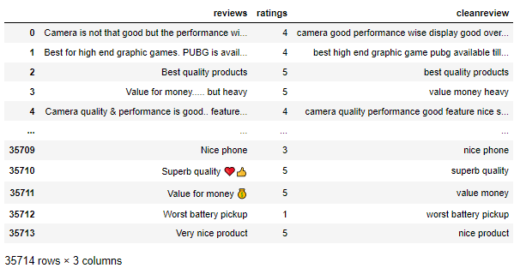
The before and after text- preprocessing:
‘cleanreview’ is clean, filtered and model ready.

Slide 10
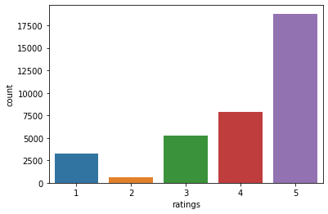
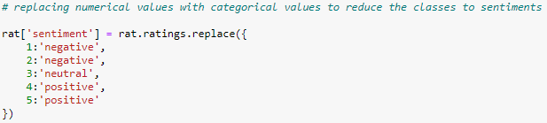
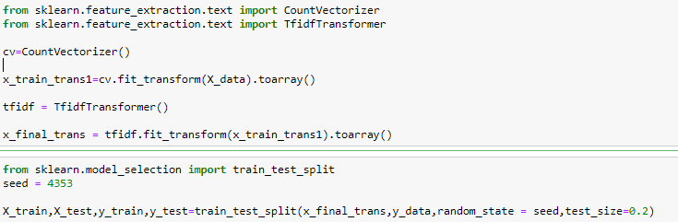
The column ‘review’ is dropped from the data.
‘ratings’ column has imbalanced data which might affect the model in the long run.
The data is reduced to sentiments like:
Data is split into X and Y, then X data is vectorized with help of CountVectorizer and TfIdf transformer:
→ with seed = 4353 we split the data into train and test.

Slide 11
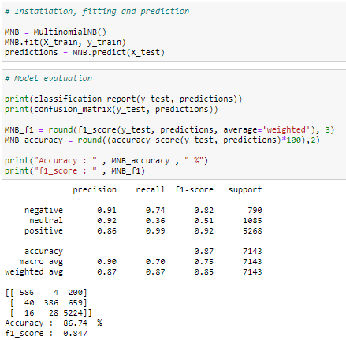
Model Building: Whatever that we’ve done till now to the data is for this stage, we build the models by using the data, train it, parameters are used, finally prediction is done. The model which gives the best accuracy score is retained and saved.
Multinomial Naïve Bayes:
→ The accuracy score is 86.74%

Slide 12
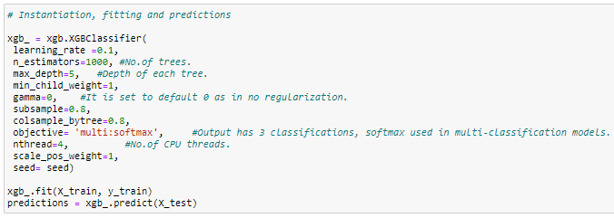
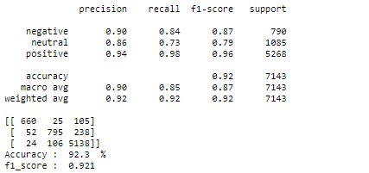
2) XGBoost:
n_estimators = no.of trees. (1000 is chosen as the data is huge)
max_depth = Depth of each tree. (5 is given to increase each tree’s grasping capacity)
objective = the aim of the model. (softmax is used since it’s a multi-classification problem)
nthread = Number of cores being utilized. (4 is given, 6 or 8 can also be given according to the machine capacity)
So on...
→ 92.3% of Accuracy score

Slide 13
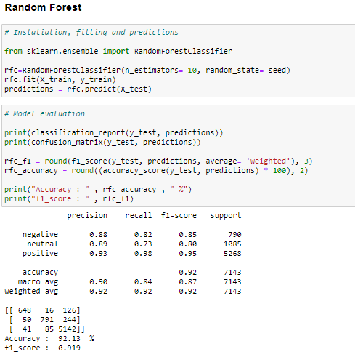
Random Forest classifier:
Accuracy is 92.13%

Slide 14
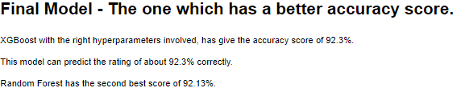
Out of all the models that were tested, XGBoost has the accuracy score.
Best accuracy score signifies best prediction.
XGBoost has predicted the result to be as crisp as 92.3%
**The model is ready for the client to use and predict the rating out of their old review texts.**
Thank you

